Slide 1

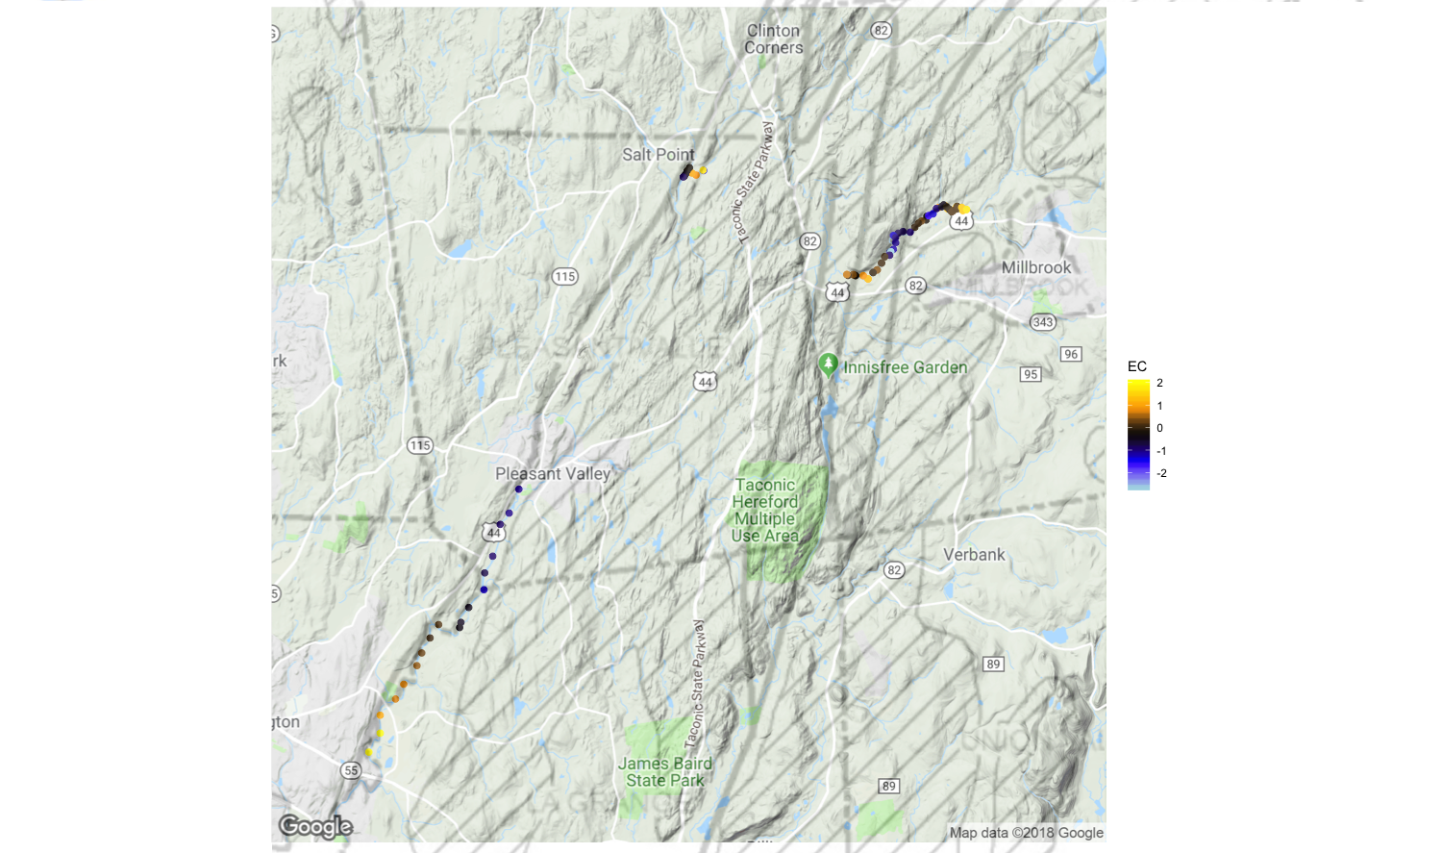
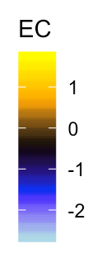
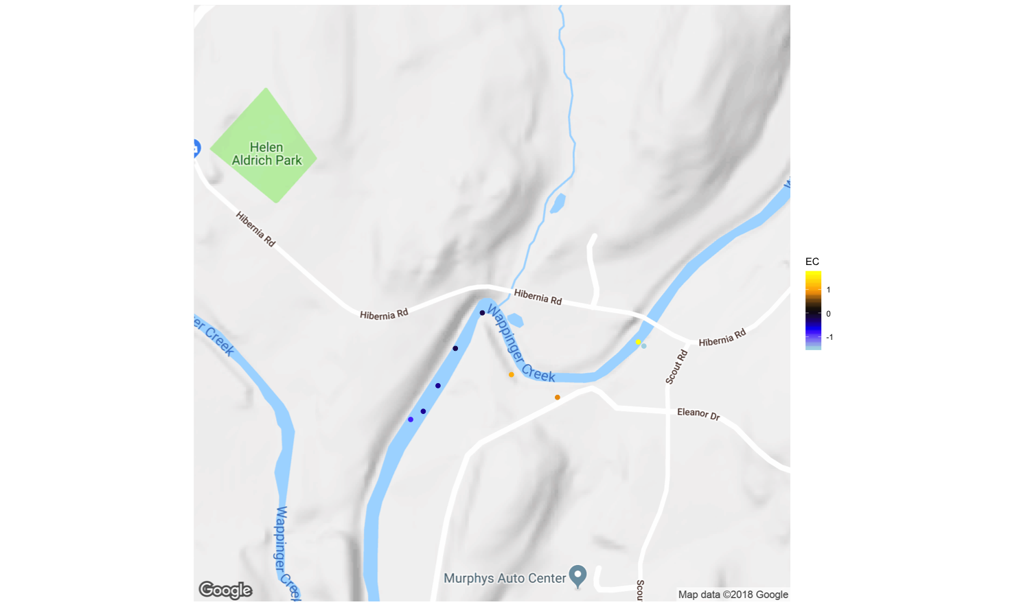
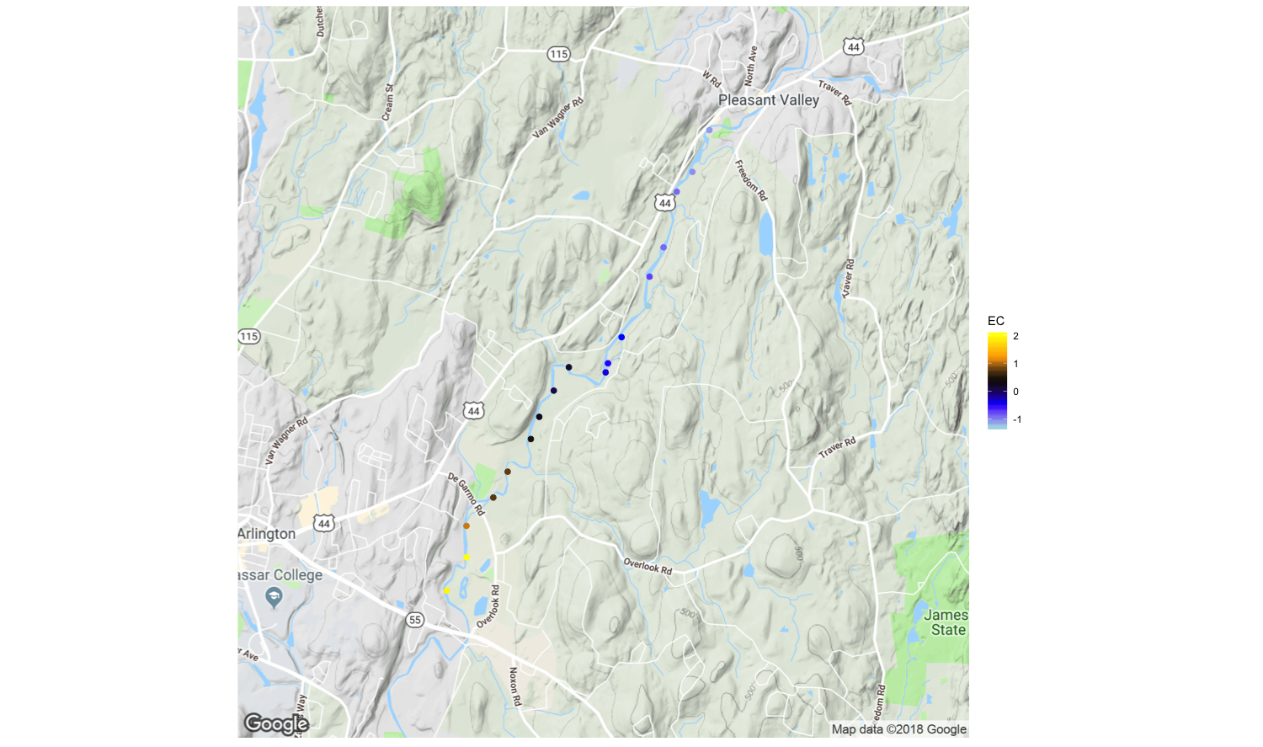
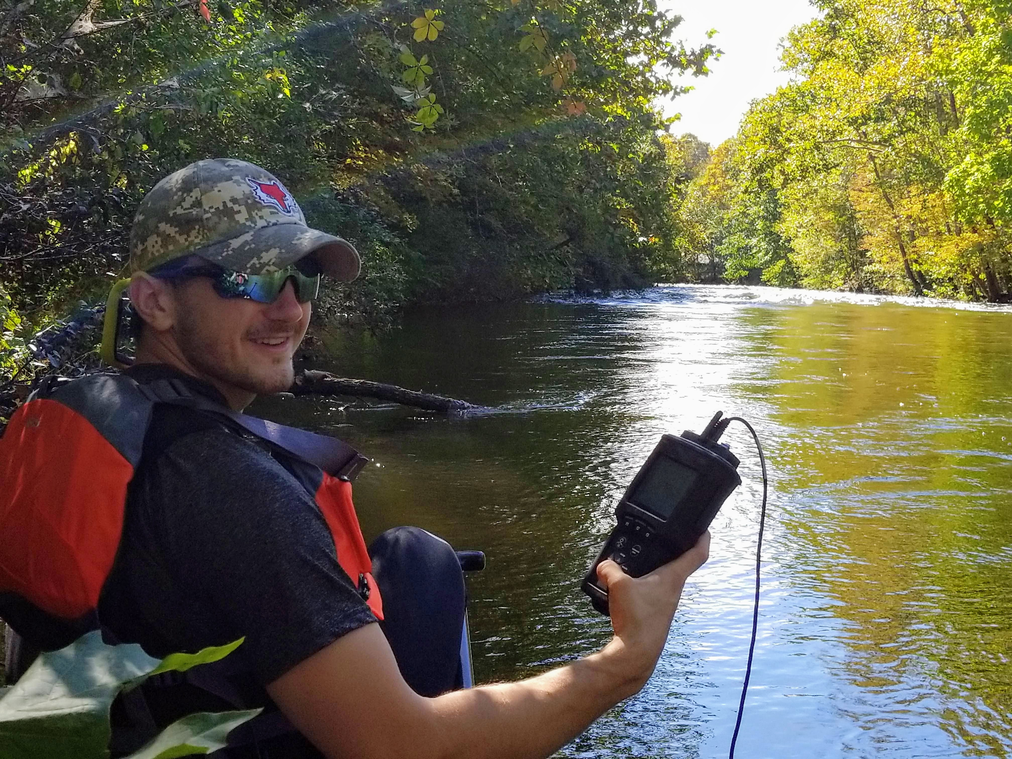
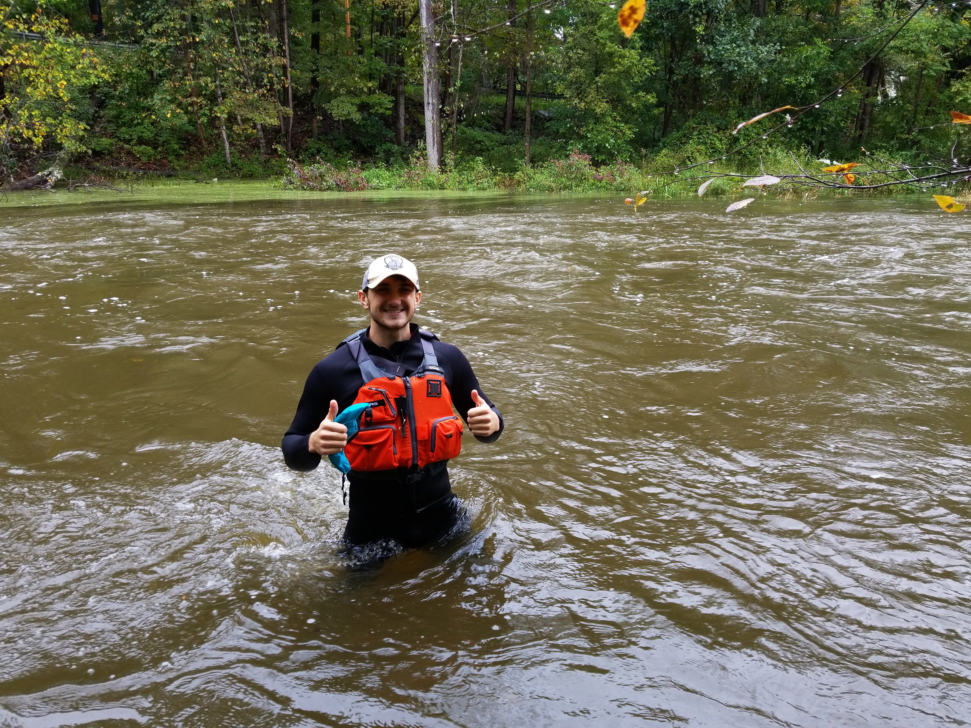
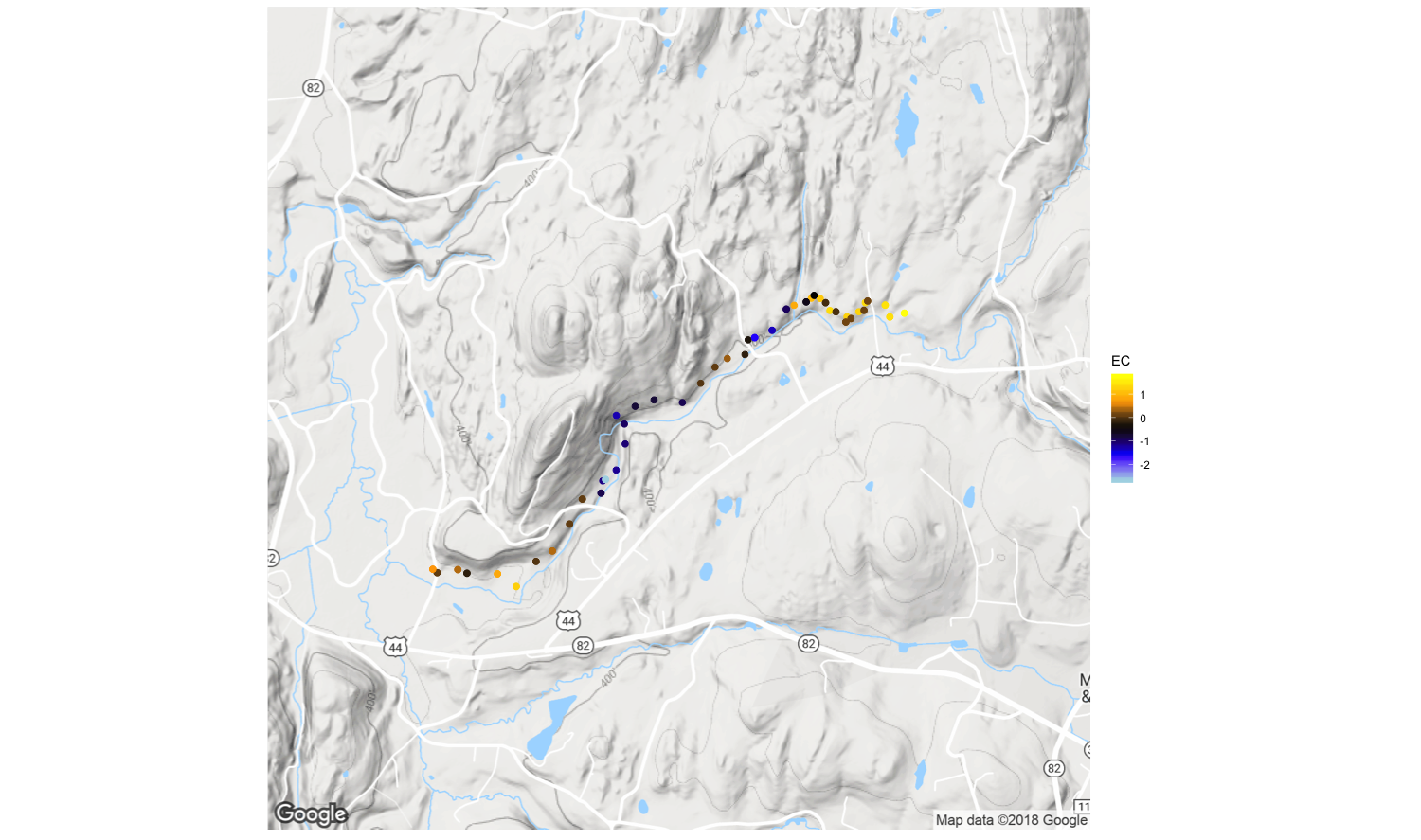
Quantifying preferential transport of higher salinity groundwater via geologic fault structures connecting highways to Wappingers Creek
Tadd Bindas School of Computer Science and Mathematics, Dr. Zion Klos School of Sciences
background
results
Results
Wappinger Creek is a local watershed in the Hudson River Valley. Like many creeks in the region, the salinity level of the stream has been rising in recent decades. These rises in salt concentrations have led to decreases in water quality and impaired ecological health of the system. We believe there is a likely link between these rises in salt concentration to the continued use of road salts on our roads and highways. The input of salt to streams from roads is often thought to be highest in winter and early spring due to the application of salts to prevent snow and ice from forming on roads. However, recent observations of salt concentrations in rivers in the region have also shown a salt concentration spike in late summer and fall. These spikes are during off-peak salt application. This time of year is when groundwater input to streams is in its highest proportion relative to other near-surface water inputs, therefore increases in groundwater salinity over time may be related to this observed increase in summer/fall stream salinity. We hypothesize previously-active fault lines are heavily controlling groundwater flow along Wappingers Creek, forming conduits for flow within the bedrock underlying the Hudson Valley.
(Right) This heat map color codes the EC values of each location to from -2 to 2 where 0 is the mean EC value. A high, positive, EC value indicates there was a spike in salinity at that collection point, while a high, negative, EC value indicates there was a freshwater spike at that collection point. The thick back lines indicate a high angle fault while the diagonal lines show a thrust fault zone.1
Contrast | Zones | X̄ | 𝑢₀ | s | n | T-score | Significant at 95%
A | 1-1 1-2 | -0.4216 | 0.5270 | 0.2582 | 5 | -8.2158 | Y
B | 2-1 2-2 | 0.9022 | -0.7217 | 0.7213 | 8 | 6.3681 | Y
C | 3-1 3-2 | -0.5961 | 0.6702 | 0.9091 | 6 | -3.412 | Y
D | 3-2 3-3 | -0.6380 | -0.5961 | 0.7884 | 17 | -0.2192 | N
E | 3-3 3-4 | 0.4336 | -0.6380 | 0.5142 | 7 | 5.5135 | Y
Site One
Site Three
Site Two
Discussion
(Below) These heat maps display zoomed-in portions of the same map above. The black lines drawn over top of the maps are where high angle faults intersect Wappingers Creek. The colors of all maps correspond to the EC meter above.
Contrast A: The results gained from this contrast indicate that the Wappingers Creek water got fresher after crossing the fault zone. This conclusion conflicts with our hypothesis. While important, this result may not disprove our hypothesis. This date was during a storm event, where freshwater input into the stream was significantly higher than usual, and a sizable tributary enters Wappingers Creek at this location. The average EC value for this day was 259.6, a value which is almost 100 micro-siemens lower than results obtained later in this study
Contrast B: The results gained from this contrast indicate that the Wappingers Creek water got saltier after crossing through the fault zone. This result confirms our hypothesis. However, data may not prove that our hypothesis is correct. This section of Wappingers Creek runs parallel to Route 44 and corresponds with the location of a tributary that may contain elevated levels of road salt from inputs from the highway that accumulated within the tributary’s hyporheic zone.
Contrast C: The results gained from this contrast indicate that the Wappingers Creek water got fresher after crossing this contrast. This result may be due to the freshwater input of a local side-steam. While in the field collecting data, we stopped and measured the salinity levels of this side stream and found there was indeed much fresh water flowing into the main stem of the creek. That side-stream could be the main reason for the lowering of salinity levels.
Contrast D: The results gained from this contrast indicate that the Wappingers Creek water got saltier after crossing the fault zone, but soon dropped again in salinity. This result may support our hypothesis. When reading the Normalized EC heatmap, it is clear that the NEC values rise after the fault, however, drastically are lowered once there is a sharp bend in the stream. There could be fresher water inputs from a local side-stream or shallow hillside groundwater input.
Contrast E: The results gained from this contrast indicate that the Wappingers Creek water got saltier after crossing through the fault zone. This result confirms our hypothesis that the water in Wappingers Creek is getting saltier after the intersection with a major fault. In this section, there were no side streams, side channels, nor road influences.
Overall: Our findings show there exists a relationship between the location of fault lines and increases in the salinity levels of Wappingers Creek, but this is often confounded by fresher water inputs from side tributaries causing significant contrasts as well.
objectives
Our specific objective for this study is to investigate the correlation between fault lines and the location of stream salt input. We are particularly interested in those fault lines located in such a way that they could move water rapidly through the subsurface from specific locations along major highways, perhaps over both kilometers of distance and topographic divides that currently separate the significant roadways from sections of the creek. We built the focus of our study on ideas put forth from a previous USGS study² from 2007-2009 involving the rise of salinity of groundwater wells in Maine due to road-salt contamination.
Site One
Site Two
Contrast A
Contrast B
Zone 2-1
methods
Zone 1-2
Zone 1-1
Zone 2-2
Site Three
Zone 3-2
Zone 3-1
To test our research hypothesis, we will be performing high spatial resolution sampling of multiple sections of Wappinger Creek with an electrical-conductivity meter logging the specific conductivity of the water, through which we can infer changes in levels of salt input to the stream along its length. Using a map of significant faults in the valley overlaid onto the route of the creek, we will walk sections of the creek that intersect major fault lines, observing any changes in salinity (via specific conductance) or temperature that may occur.
Zone 3-3
Contrast C
Zone3-4
Contrast D
Contrast E
Sources
Each sampling site is broken up into zones based on local geomorphologic features. Each zone will then be compared to the zone downstream of it to determine if the water downstream of a geomorphic feature is saltier, or fresher. We will be using t-statistics for this test (above).
1. Budnik, R. T., Walker, J. R., & Menking, K. (2010). Geology and Topography of Dutchess County , NY.
2. Schalk, C. W., & Stasulis, N. W. (2012). Relations Among Water Levels, Specific Conductance, and Depths of Bedrock Fractures in Four Road-Salt- Contaminated Wells in Maine, 2007–9, 47. Retrieved from http://pubs.usgs.gov/sir/2012/5205

